Slide 1
EMI Data from Nipun
21-10-2014

Slide 2
System Configuration
Start Freq. = 100 kHz (Min. in SA there)
Stop Freq. = 5 MHz
Line Voltage = 115V

Slide 3
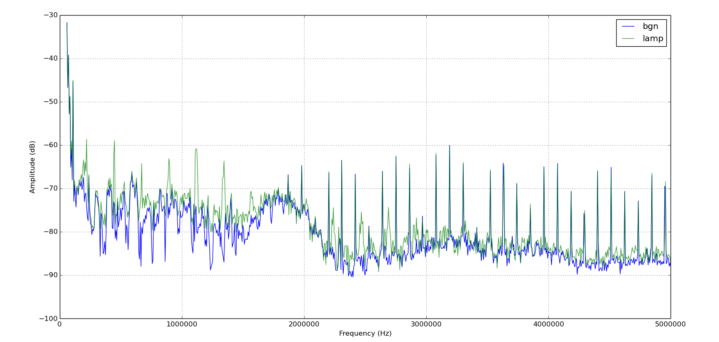
Lamp on Mains Power

Slide 4
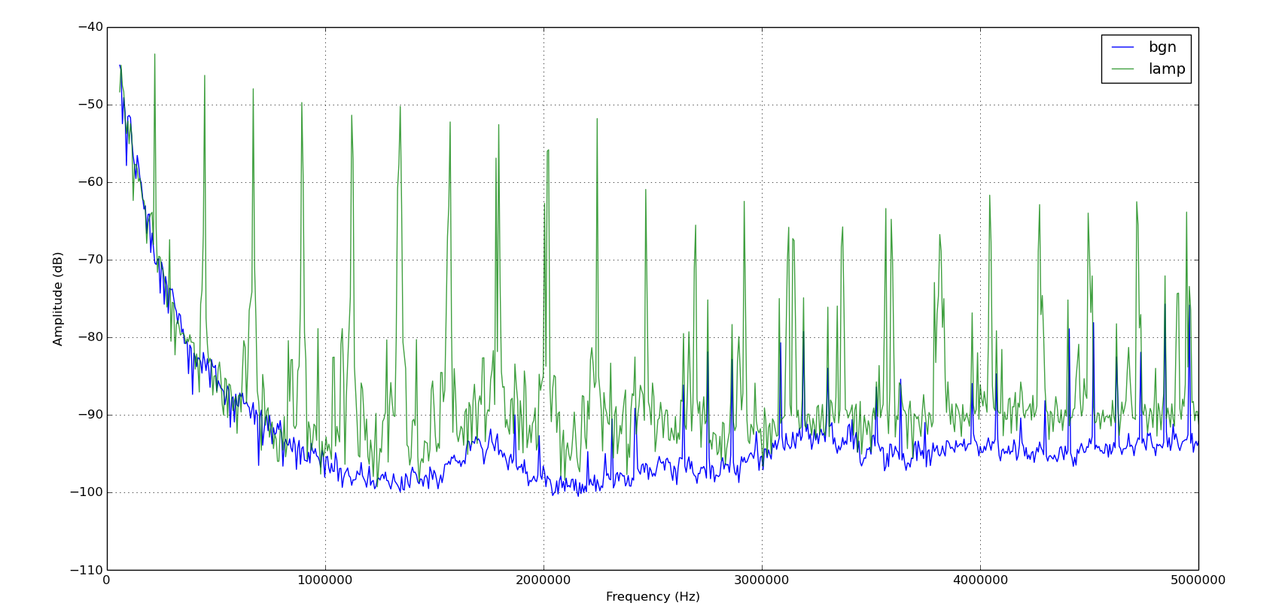
Lamp on UPS Power

Slide 5
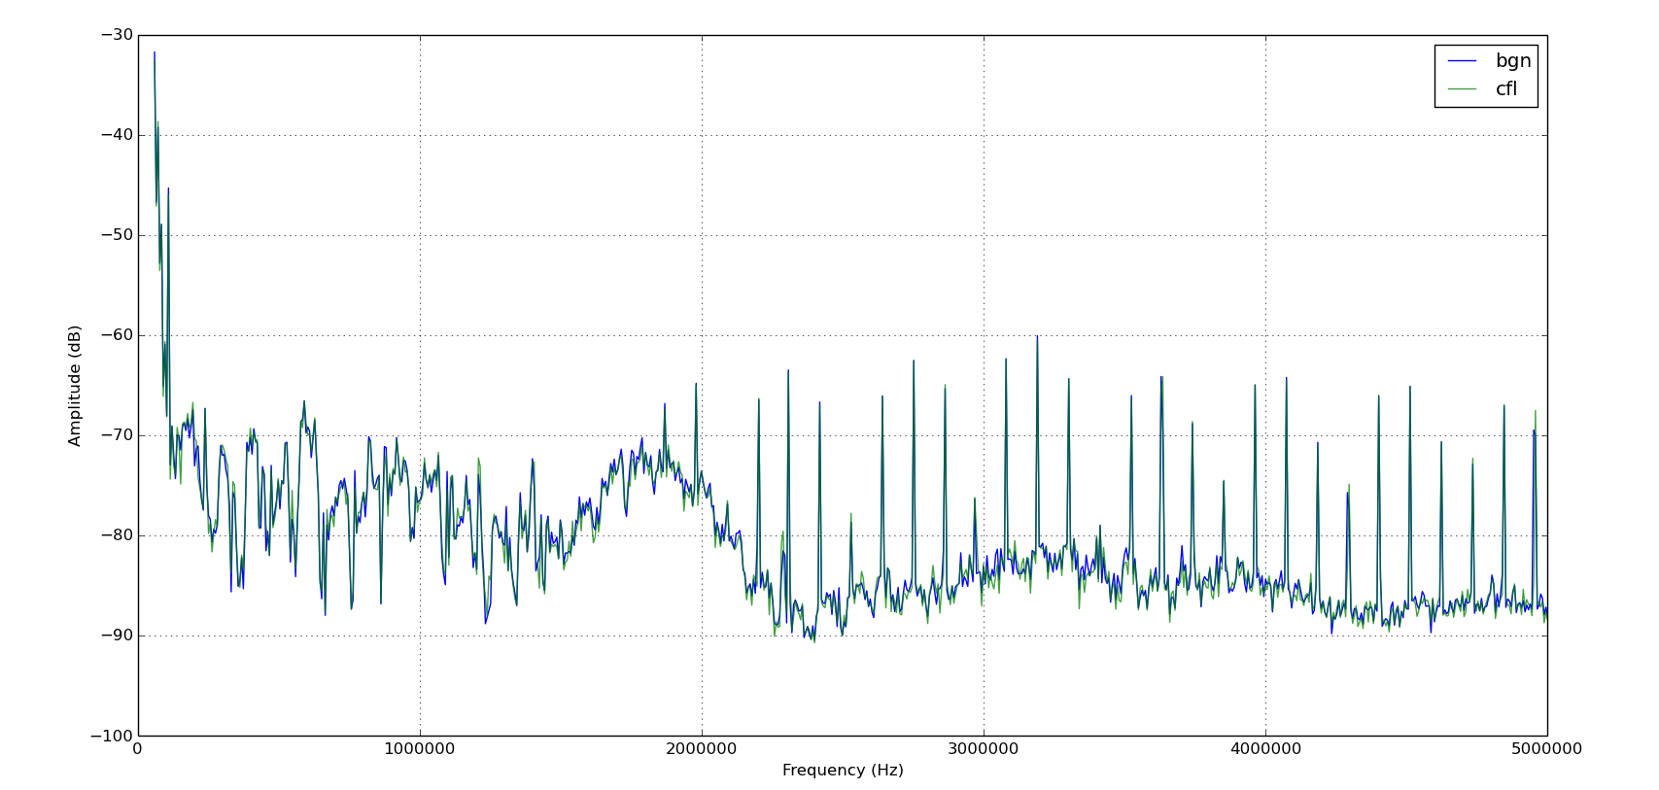
CFL on Mains Power

Slide 6
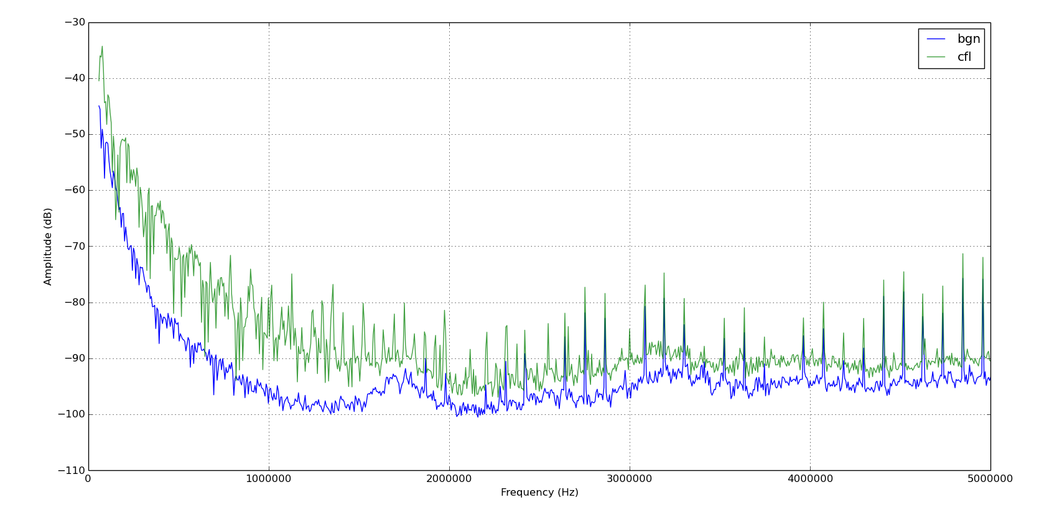
CFL on UPS Power

Slide 7
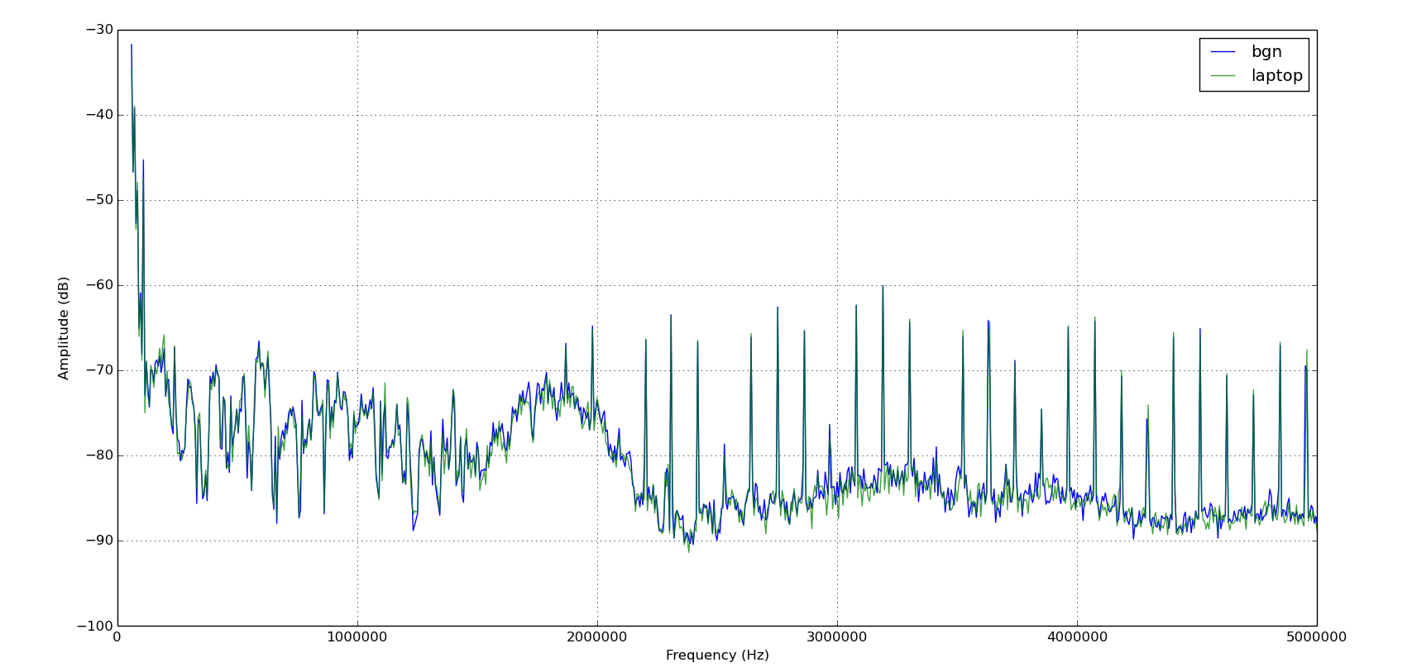
Laptop on Mains Power

Slide 8
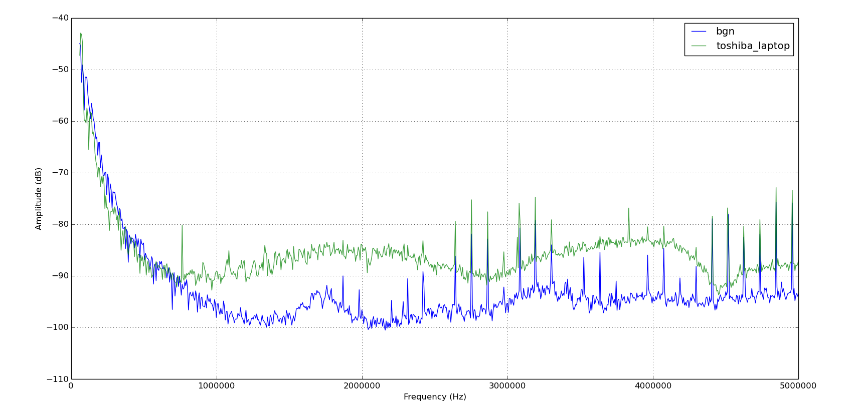
Laptop on UPS Power

Slide 9
Lamp on UPS Power

Slide 10
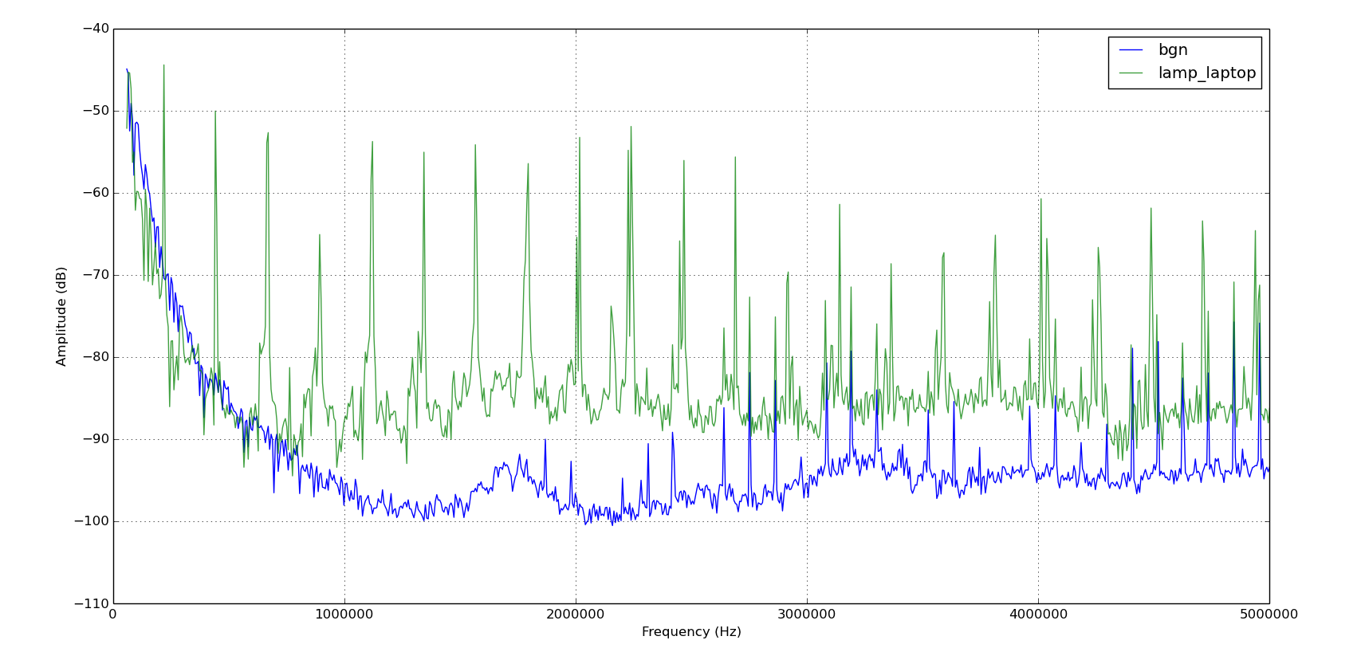
Lamp+Laptop on UPS Power

